Slide 1

Anglophone West School District (ASD-W)
Multi-year infrastructure planning
Chipman/Minto Study (K to 12)
New Brunswick Department of Education
and Early Childhood Development (EECD)
11 April 2019
Presentation

Slide 2
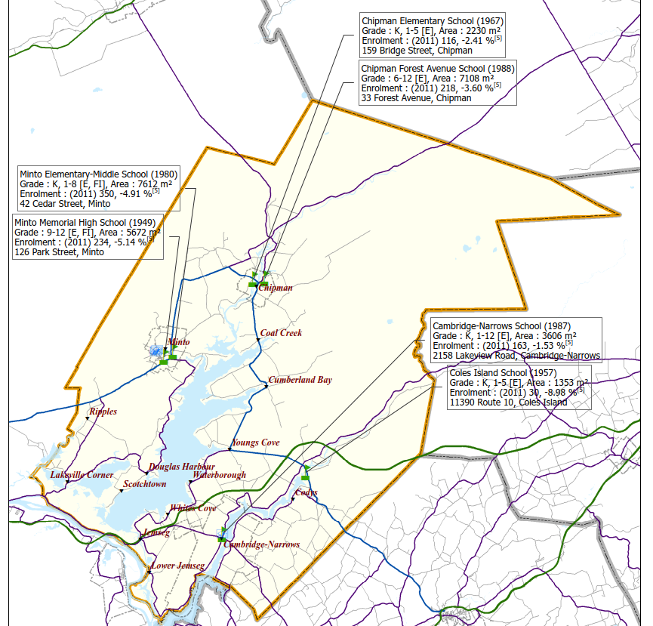
Scope – ASD-W has initiated a review of the four schools in the Chipman and Minto area to examine potential scenarios for long-term infrastructure planning
  Chipman and Minto Schools
  Subject schools – year built
  Chipman Elementary School (K to 5 – 1967)
  Chipman Forest Avenue School (6 to 12 – 1988)
  Minto Elementary Middle School (K to 8 – 1980)
  Minto Memorial High School (9 to 12 – 1949)
  Average age of the subject infrastructure:
  48 years
Note:
Chipman Forest Avenue School was initially constructed in 1988 and had the soccer field renovated in 2015.
Minto Memorial High School was constructed in 1949, had a gymnasium addition in 2003, and a shop addition in 2009.
Note:
Coles Island School was amalgamated in 2015-16 and students had option to switch to either Chipman or Cambridge Narrows.
The Early French Immersion (EFI) Program is at Minto Elementary Middle School.
Source: EECD sub-district map 11 for ASD-W.

Slide 3
Scope – Consultations between the District and EY narrowed the scope to five potential scenarios to be summarized for the infrastructure review
The following scenarios were included within the scope of the Chipman/Minto infrastructure planning review. Each scenario was based on space requirements identified in the EECD Planning Guidelines for Educational Facilities, with enrolment projections for the schools developed by mapping 2016 Census data (Statistics Canada) to the school boundaries in order to determine future space requirements:
Scenario 1: Close Chipman Elementary School, re-configure Chipman Forest Avenue School to a K-12 school, and determine what renovations/additions would be required based on the EECD Planning Guidelines for Educational Facilities (288 combined student enrolment in 2017-18). Close Minto Elementary Middle School and Minto Memorial High school. Replace with a new K-12 school (487 combined student enrolment in 2017-18). Develop a Class “D” (± 30%) estimate for the construction costs of the new school/renovations/additions.
Scenario 2: Close Chipman Elementary School, re-configure Chipman Forest Avenue School to a K-12 school and determine what renovations/additions would be required based on the EECD Planning Guidelines for Educational Facilities (288 combined student enrolment in 2017-18). Close Minto Memorial High School, re-configure Minto Elementary Middle School to a K-12 school and determine what renovations/additions would be required based on the EECD Planning Guidelines for Educational Facilities (487 combined student enrolment in 2017-18). Develop a Class “D” (± 30%) estimate for the construction costs of the new school/renovations/additions.
Note: Construction estimates in the report are for planning purposes only to be used in scenario comparison. Actual costs can be wide-ranging depending on soft costs (design work, real estate costs, project management, etc.), size, topography, geotechnical engineering, and other existing conditions. Estimates are considered class “D” (± 30%) estimate for the construction costs of the new schools based on the space requirements identified in the EECD Planning Guidelines for Educational Facilities.

Slide 4
Scope – Consultations between the District and EY narrowed the scope to five potential scenarios to be summarized for the infrastructure review (continued)
Scenario 3: Close Chipman Forest Avenue School and Minto Memorial High School. Replace with a new 6-12 school serving both communities (411 combined student enrolment in 2017-18). Leave the Elementary school systems as is (241 students in Minto Elementary Middle School and 123 students in Chipman Elementary School based on the 2017-18 enrolments). Develop a Class “D” (± 30%) estimate for the construction costs of the new school.
Scenario 4: Close Chipman Elementary School, Chipman Forest Avenue School, Minto Elementary Middle School and Minto Memorial High School. Replace these schools with a new K-12 school serving both communities (775 combined student enrolment in 2017-18). Develop a Class “D” (± 30%) estimate for the construction costs of the new school.
Scenario 5: Close Chipman Elementary School and re-configure Chipman Forest Avenue School to a K-12 school. Determine what renovations/additions would be required based on the EECD Planning Guidelines for Educational Facilities (422 combined student enrolment in 2017-18, which includes Minto Memorial High School). Close Minto Memorial High School and have the high school students attend a re-configured K-12 Chipman Forest Avenue School. Minto Elementary Middle School would remain a K-8 school (353 student enrolment in 2017-18). Develop a Class “D” (± 30%) estimate for the construction costs of any renovations/additions.
Determine the pros and cons of each scenario considering both pedagogical and fiscal requirements.
Note: Construction estimates in the report are for planning purposes only to be used in scenario comparison. Actual costs can be wide-ranging depending on soft costs (design work, real estate costs, project management, etc.), size, topography, geotechnical engineering, and other existing conditions. Estimates are considered class “D” (± 30%) estimate for the construction costs of the new schools based on the space requirements identified in the EECD Planning Guidelines for Educational Facilities.

Slide 5
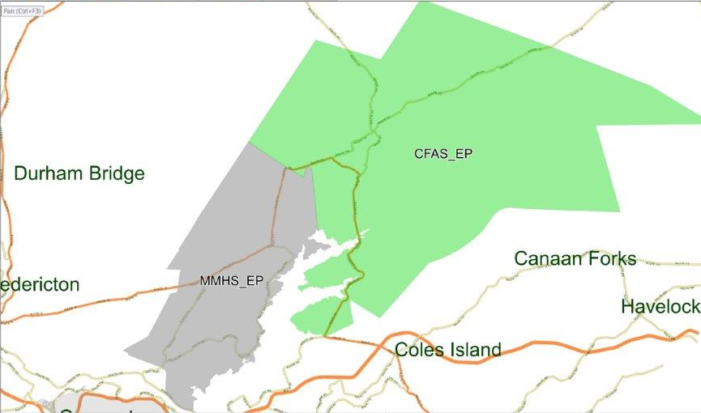
Overview of feed schools in the Chipman and Minto Area – Existing school boundaries
Chipman Elementary School
Chipman Forest Avenue School
Minto Elementary Middle School
Minto Memorial High School
Northumberland County Line
Queens County Line
Kent County Line
Sunbury County Line
NB-123
NB-116
York County Line
NB-116
Sunbury County Line
NB-123
NB-10
NB-10
Chipman Forest Avenue School Boundary
Duffys Corner
NB-10
NB-10
Minto Memorial High School Boundary
Grand Lake
NB-10
NB-670
NB-10
NB-690
Youngs Cove
NB-10
Lakeville Corner
NB-105
Foshay Lake
Trans-Canada Highway
NB-105
Source: ASD-W school transportation software - Busplanner.

Slide 6
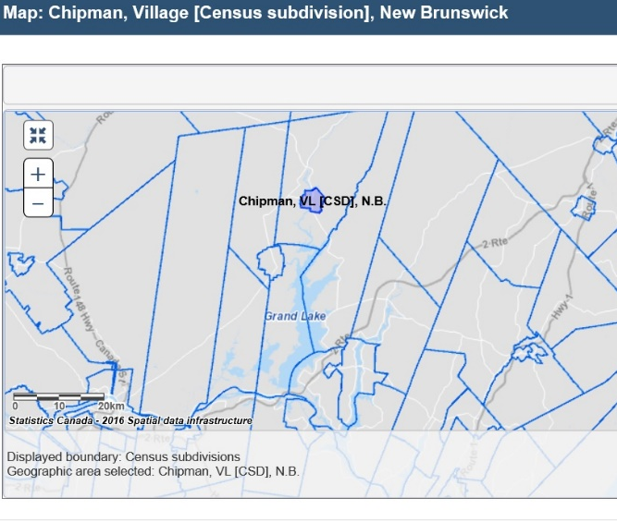
2016 Census data – Chipman K-12 schools projected to see a decrease in enrolment (based on the population age grouping census data), excluding net migration (1 of 2)
Boundary for Chipman (VL)
  Service New Brunswick (SNB) vital statistics for Queens County birth trend from 2013 to 2017: 70, 67, 54, 60, and 61.
  SNB Vital statistics for Chipman Village birth trend from 2013 to 2017: 11, 4, 3, 6, and 3.
  Preliminary SNB estimates for New Brunswick births show 5,448* children were born in 2018, a decrease of 17%* to the 6,543 born in 2017.
  (*Note: Final statistics for NB to be released in April, they will be closer to the 2017 birth total after all of the birth certificates have been compiled.)
*Sources: Statistics Canada. 2017. Chipman, VL [Census subdivision], New Brunswick and Queens, CT [Census division], New Brunswick (table). Census Profile. 2016 Census. Statistics Canada Catalogue no. 98-316-X2016001. Ottawa. Released November 29, 2017. Vital Statistics, Table 2A: Vital Statistics by County of Residence,
New Brunswick and Table 4: Vital Statistics by Cities, Towns and Villages of Over 1,000 Population, New Brunswick (2013-2017).

Slide 7
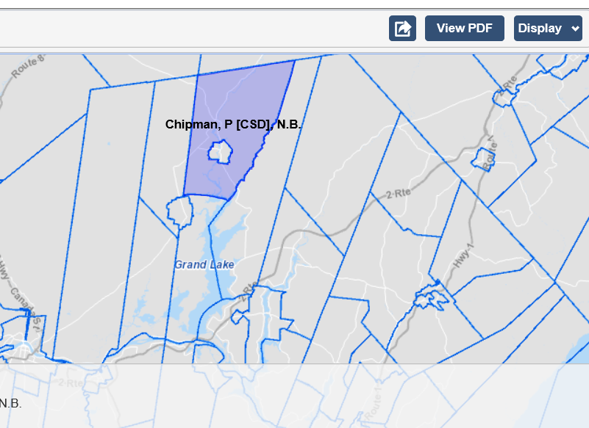
2016 Census data – Chipman K-12 schools projected to see a decrease in enrolment (based on the population age grouping census data), excluding net migration (2 of 2)
Parishes surrounding Chipman
Northfield, P
Chipman, VL
Minto, VL
Waterborough, P
Canning, P
  The majority of the enrolment decrease has come from the birth decline in the surrounding parishes, while Chipman Village has seen a small decrease in the last 5 years.
  J.D. Irving, Limited has noted in addition to focusing on this region, they are also recruiting employees from other provinces and countries since 2015. They anticipate their recruitment efforts will help increase K-12 enrolments in Chipman.
*Source: Statistics Canada. 2017. Chipman, VL, Chipman Parish, Waterborough Parish [Census subdivisions], New Brunswick and Queens, CT [Census division], New Brunswick (table). Census Profile. 2016 Census. Statistics Canada Catalogue no. 98-316-X2016001. Ottawa. Released November 29, 2017, and Village of Chipman Letter
(dated 4 October 2018).

Slide 8
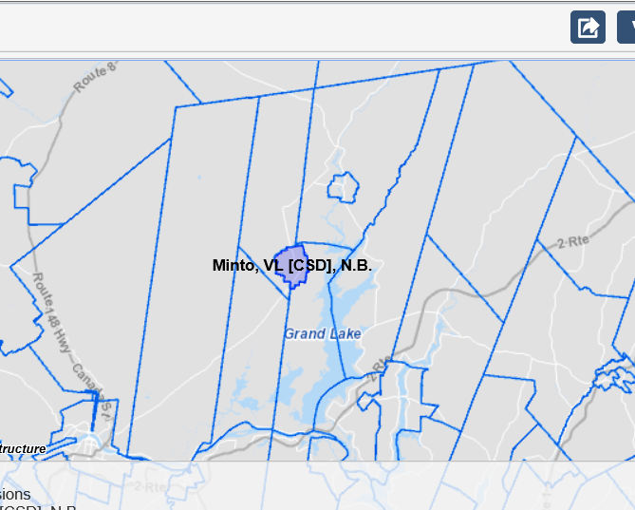
2016 Census data – Minto K-12 schools projected to see a decrease in enrolment (based on the population age grouping census data), excluding net migration (1 of 2)
Boundary for Minto (VL)
  Service New Brunswick (SNB) vital statistics for Queens County birth trend from 2013 to 2017: 70, 67, 54, 60, and 61. Sunbury County births: 346, 364, 339, 374, and 337.
  SNB Vital statistics for Minto Village birth trend from 2013 to 2017: 20, 15, 16, 15, and 18.
  The EFI program is taught at Minto Elementary and Middle School. (As of 2018-19: up to grade 4 and will eventually expand to high school).
*Source: Statistics Canada. 2017. Minto, VL [Census subdivision], New Brunswick and Queens, CT [Census division], New Brunswick (table). Census Profile. 2016 Census. Statistics Canada Catalogue no. 98-316-X2016001. Ottawa. Released November 29, 2017, and Vital Statistics, Table 2A: Vital Statistics by County of Residence,
New Brunswick and Table 4: Vital Statistics by Cities, Towns and Villages of Over 1,000 Population, New Brunswick (2013-2017).

Slide 9
2016 Census data – Minto K-12 schools projected to see a decrease in enrolment (based on the population age grouping census data), excluding net migration (2 of 2)
Parishes surrounding Minto
Chipman, P
Northfield, P
Chipman, VL
Sheffield, P
Maugerville, P
Canning, P
  Enrolment decrease has come from the birth decline in both the surrounding parishes and Minto Village.
  Over the past 8 years there has been a 20% decrease in K-12 enrolments between 2010-11 (618) to 2018-19 (494).
*Source: Statistics Canada. 2017. Minto, VL, Northfield Parish, Sheffield Parish, Canning Parish [Census subdivisions], New Brunswick and Queens, CT [Census division], New Brunswick (table). Census Profile. 2016 Census. Statistics Canada Catalogue no. 98-316-X2016001. Ottawa. Released November 29, 2017.
(dated 4 October 2018).

Slide 10
Mapping 2016 Census data – K-12 enrolment in the Chipman catchment area projected to increase in the next three years with anticipated newcomers for J.D. Irving Ltd. job vacancies
  Note: The Census data quality reported by Statistics Canada is 3.0% for Chipman Village and this was used to forecast the upper limits in the enrolment projections.
Sources: Statistics Canada. 2017. Chipman, VL [Census subdivision], New Brunswick and Queens, CT [Census division], New Brunswick (table). Census Profile. 2016 Census. Statistics Canada Catalogue no. 98-316-X2016001. Ottawa. Released November 29, 2017. Vital Statistics, Table 2A: Vital Statistics by County of Residence,
New Brunswick and Table 4: Vital Statistics by Cities, Towns and Villages of Over 1,000 Population, New Brunswick (2013-2017), and ASD-W 2000-2018
enrolment data, and Village of Chipman Letter (dated 4 October 2018).

Slide 11
Mapping 2016 Census data – Total enrolment for K-12 in the Minto catchment area projected to continue downward based on census mapping and vital statistics
  Note: The Census data quality reported by Statistics Canada is 3.9% for Minto Village (rounded to +/-4.0%) and this was used to forecast the upper and lower limits in the enrolment projections.
Sources: Statistics Canada. 2017. Minto, VL [Census subdivision], New Brunswick and Queens, CT [Census division], New Brunswick (table). Census Profile. 2016 Census. Statistics Canada Catalogue no. 98-316-X2016001. Ottawa. Released November 29, 2017. Vital Statistics, Table 2A: Vital Statistics by County of Residence,
New Brunswick and Table 4: Vital Statistics by Cities, Towns and Villages of Over 1,000 Population, New Brunswick (2013-2017), and ASD-W 2000-2018
enrolment data.

Slide 12
Scenarios 1 and 2 (K-12 schools in both communities) are estimated to be $36.4M* and $15.5M* respectively, recommend scenario have building assessment studies
Main Street
Scenarios 1 and 2 both have a minimum affect on school busing, as each community would have a K-12 school. Some of the vocational shop space may be converted for the middle school program in a school re-configuration as per the Planning Guidelines.
Recommend a building assessment be performed to confirm the investment in addition costs to Chipman Forest Avenue (built in 1988) and Minto Elementary Middle School (built in 1980) are not outweighed by the potential repair costs of a mid-life upgrade.
Chipman Forest Avenue School is projected to be at an enrolment of 300 students, which is the limit for being classified a small mixed school. If the forecasted immigration identified by the Village of Chipman is not realized, the school would remain classified as small and this would reduce the space allocations for the addition based on the Planning Guidelines.
*Note: Class "D" estimate (± 30%) based on the EECD Planning Guidelines for Educational Facilities, as an estimate for this report only. Estimates will be adjusted when EECD Infrastructure and the project team establish the actual space allocation.

Slide 13
Scenarios 3, 4 and 5 all significantly impact school transportation, and suggest that the two communities share school infrastructure
Main Street
All three scenarios significantly impact school busing with the school boundary encircling Foshay Lake and Grand Lake. Locating a new school approximately half-way between the two communities would split in two the furthest distance travelled from each boundary. E.g.: the furthest point from Minto school boundary to Chipman is approximately 54 km (double the current distance). The furthest point from Chipman school boundary to Minto is approximately 61 km (21 km further than the current distance).
Of the three scenarios, number 5 has the least effect on transportation as only the high school students from Minto would have the extra commute compared to the entire catchment area. As in scenarios 1 and 2, some of the vocational shop space may be converted for the middle school program in a school re-configuration. Additionally, it is recommended that a building assessment be performed to confirm the investment in addition costs to Chipman Forest Avenue (built in 1988) are not outweighed by the potential repair costs of a mid-life upgrade.
*Note: Class "D" estimate (± 30%) based on the EECD Planning Guidelines for Educational Facilities, as an estimate for this report only. Estimates will be adjusted when EECD Infrastructure and the project team establish the actual space allocation.

Slide 14
EY | Assurance | Tax | Transactions | Advisory
About EY
EY is a global leader in assurance, tax, transaction and advisory services. The insights and quality services we deliver help build trust and confidence in the capital markets and in economies the world over. We develop outstanding leaders who team to deliver on our promises to all of our stakeholders. In so doing, we play a critical role in building a better working world for our people, for our clients and for our communities.
EY refers to the global organization, and may refer to one or more, of the member firms of Ernst & Young Global Limited, each of which is a separate legal entity. Ernst & Young Global Limited, a UK company limited by guarantee, does not provide services to clients.
For more information about our organization, please visit ey.com.
© 2019 Ernst & Young LLP. All Rights Reserved.
A member firm of Ernst & Young Global Limited.
This publication contains information in summary form, current as of the date of publication, and is intended for general guidance only. It should not be regarded as comprehensive or a substitute for professional advice. Before taking any particular course of action, contact Ernst & Young or another professional advisor to discuss these matters in the context of your particular circumstances. We accept no responsibility for any loss or damage occasioned by your reliance on information contained in this publication.
ey.com/ca/private

